Slide 1
GROUP 4 PROJECT PRESENTATION BUSINESS MACHINE LEARNING-1 DUE DATE:04/16/2022 SPRING TERM 2023
SREE MALYA BATHINA(U00865130)
DEEPTHI REDDY CHADA(U00870116)
SAITEJA GUDIDeViNI(U00860894)
VINAY MANCHALA(U00868525)

Slide 2
Rainfall prediction of Australia using machine learning and visualization SAS and Tableau

Slide 3
Introduction
Weather analysis can be done using machine learning. For instance, based on previous weather data, machine learning models can be used to forecast the likelihood of rain or snow in a specific area. Additionally, patterns in meteorological data, such as changes in temperature or the beginning of rain, can be found using machine learning algorithms. Machine learning algorithms can be applied to the analysis of satellite data to spot environmental changes like shifts in vegetation or land cover.

Slide 4
Objectives
The research objectives are explain below
The data will be imported in SAS and classification models such as decision tree will be applied to predict rainfall in Australia
The visualisations of the variables will be performed using Tableau and findings will be interpreted that are valuable for prediction
Data exploration will be carried out to look into the most important variables used for prediction of rainfall

Slide 5
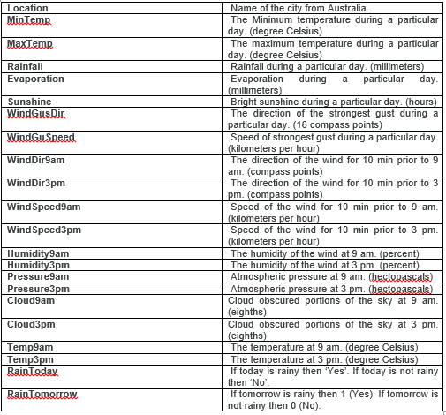
Dataset
The data contain a total of 99516 entries with 23 columns.
https://www.kaggle.com/datasets/arunavakrchakraborty/australia-weather-data
The description of the variables in the data is explained below

Slide 6
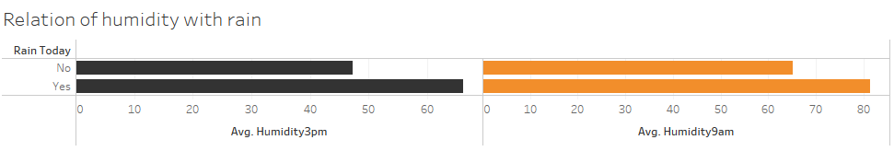
Findings and Interpretation
The average humidity is recorded at morning and evening where the average humidity seem to be higher when it rains but when it does not rain, the average humidity remains lower. So humidity can be useful to predict whether it is going to rain today or not.

Slide 7
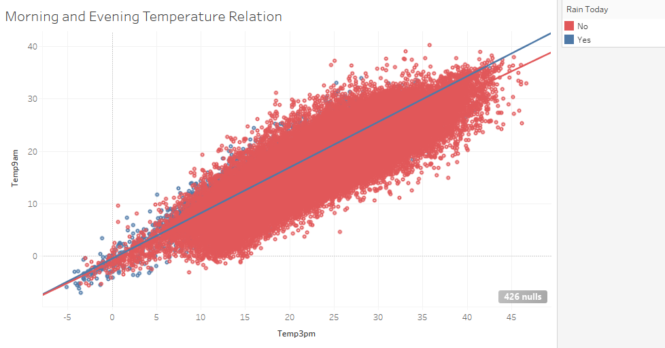
The relation between the morning and evening temperature can be seen in both raining and not raining condition. In raining condition, the morning and evening temperature seem to be highly correlated while in not raining condition the evening temperature seem to have a bit lower correlation.
This indicates that increase of morning temperature surely increase the evening temperature and vice versa.

Slide 8
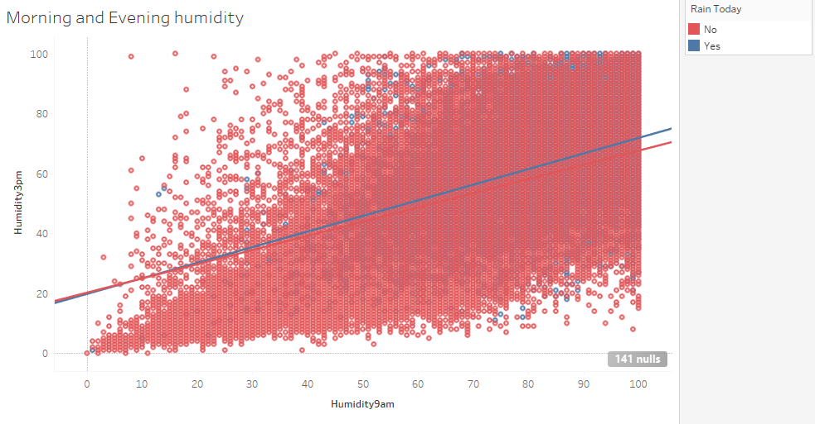
Similarly the morning and evening humidity is recorded where they both same to have good correlation with raining and not raining condition. So increase of morning humidity increases the evening humidity.

Slide 9
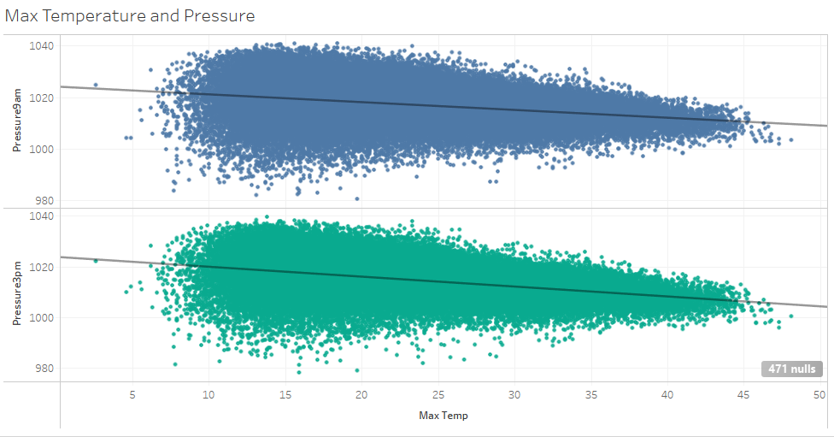
The maximum temperature also have good relation with the pressure recorded at morning and evening sessions. It is seen that when the maximum temperature increases, the pressure decreases in both the cases.

Slide 10
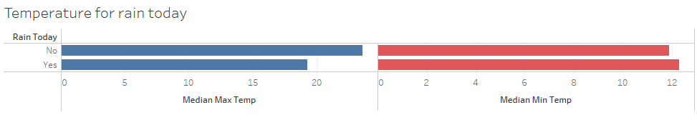
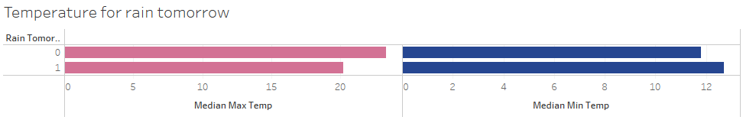
The median temperature at maximum and minimum level is recorded when it is seen that the maximum temperature remains lower in case of raining but the minimum temperature remains higher in case of raining. This can be another important features to forecast rainfall in Australia.
The median maximum and minimum temperature is also recorded to forecast tomorrow rainfall where it is seen that the maximum temperature is lower in predicting tomorrow's rainfall but the minimum temperature is higher. So this show similar statistics for forecasting today's and tomorrow's rainfall.

Slide 11
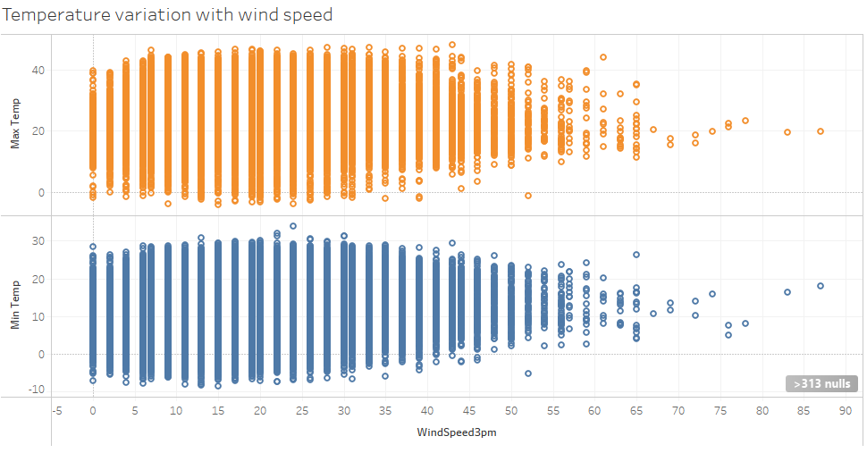
The maximum temperature is visualized with wind speed recorded at 3 pm where it is observed that there is no significant effect between the two factors but the plot shows there are very less samples recorded at high wind speed.

Slide 12
Data Exploration and Preprocessing
Initially, the variables are inspected using MS Excel and after that it is imported in Tableau. The data is found to be clean.
Missing Data
There are missing values found in all the columns except location and rain tomorrow feature. The missing values will be neglected once the data is fed into SAS Workspace.
Data Inconsistency
All the feature recorded are highly relevant to forecast rainfall.
Data Reduction
The data contain enough entries to represent rainfall of Australia. Also some variables like row ID, evaporation and sunshine contain irrelevant and highly missing observations. So such variables will be reduced.

Slide 13
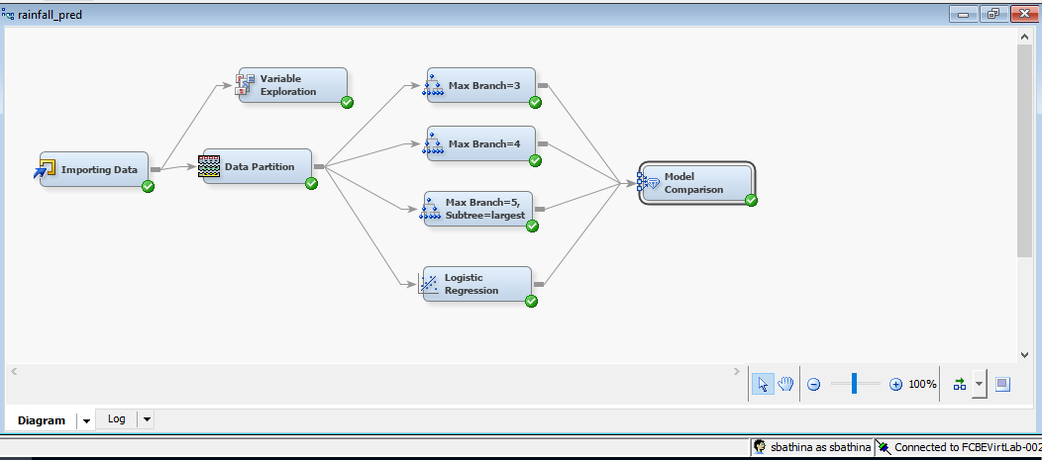
Models’ Overview
We have built the following models in SAS where we compared the performance and selected the final model that gave the least error during prediction of rainfall in test data.

Slide 14
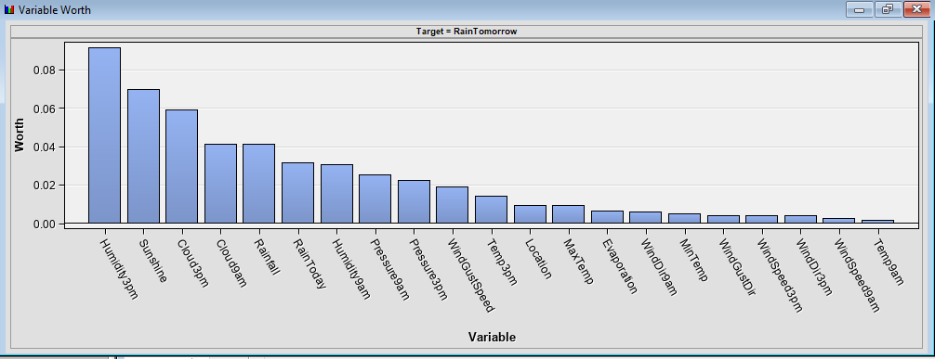
The evening humidity, sunrise and evening cloud are considered to be the important variable to decide whether it will rain tomorrow or not.
There are end number of input variables which shows that most of the variables have significance more than 20% and there are variables like humidity3pm which has the highest significance.

Slide 15
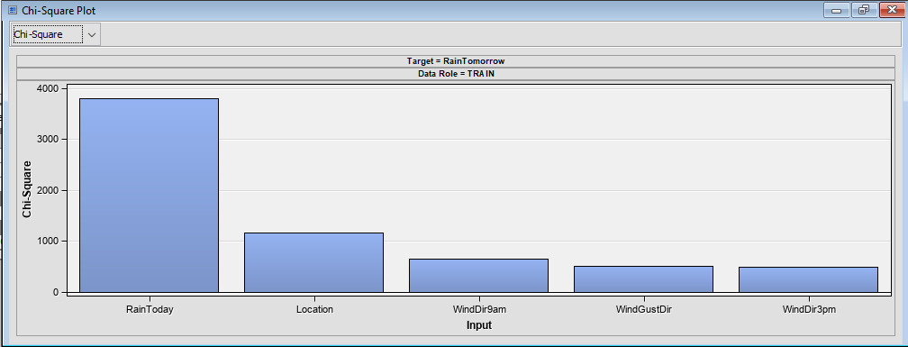
Chi square is a statistical test that is used to compare a collection of the values observed to a set of anticipated values. It is used to determine how probable it is that a set of results occurred by chance. It is frequently used to determine the independence of two variables.
The variable RainToday, Location, WindDir9am are showing good importance to the outcome.

Slide 16
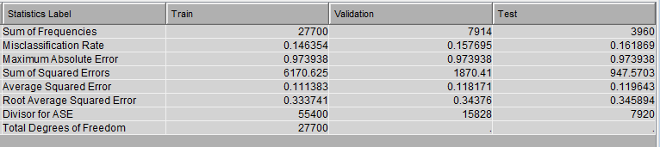
Decision Tree having Max Branch=3
The statistics of the result is mentioned above from which we can see that the mis classification rate of test samples is higher than the train samples. The model is having a good generalization performance where the model is predicting the test data with lower mis classification rate.

Slide 17
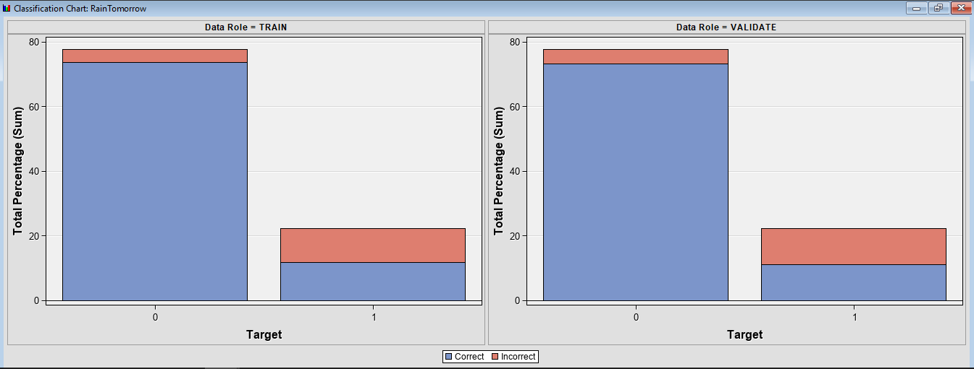
The minority samples are having higher mis classification compared to the majority samples. From the graph, we can infer that the model did not learn much from the minority samples and can give high error for prediction of tomorrow's rainfall.

Slide 18
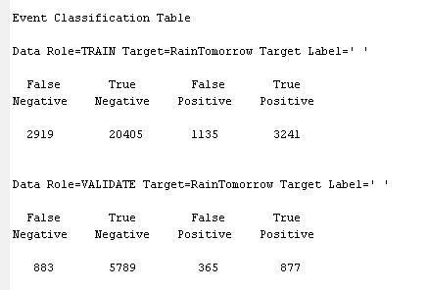
The event classification table provide the exact number of samples that are misclassified in train and validation data. In minority samples, around 877 samples are classified correctly and rest to the samples are miss classified.

Slide 19
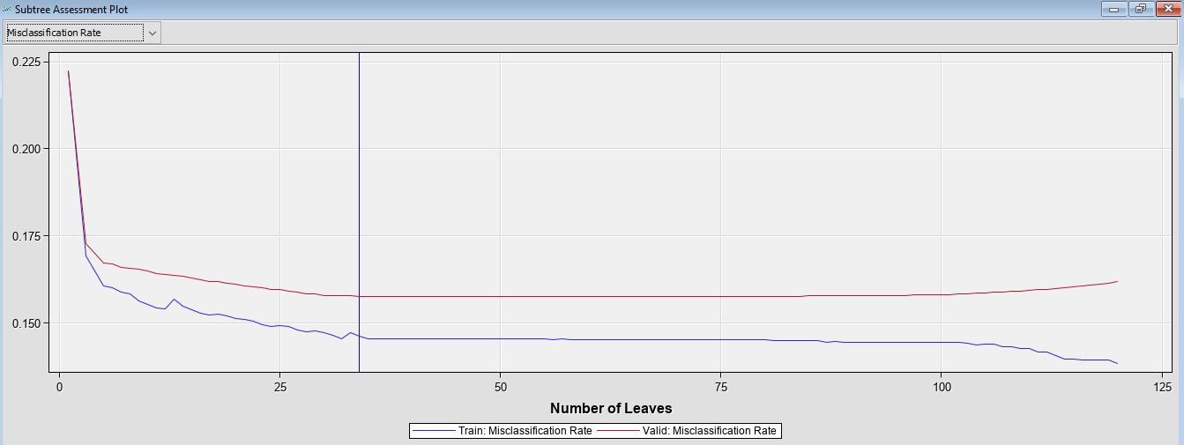
From the subtree assessment plot we can observe that the mis classification rate is higher in validation as the number of leaves increase in the tree. Since the valid error is much higher than the train error, we can say that the model is bound to give overfitting result in forecasting of tomorrow's rainfall.

Slide 20
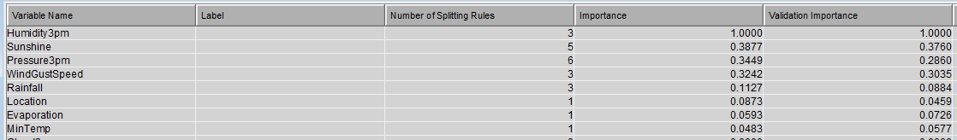
The decision tree assume the humidity 3pm is the most important variable for prediction of rainfall. So we can say that from evening humidity, we can forecast tomorrow's rainfall.

Slide 21
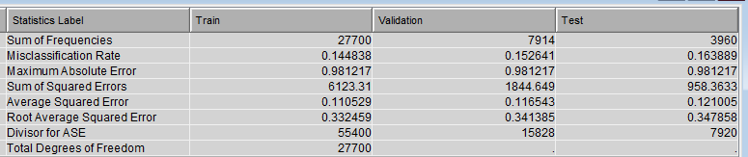
Decision Tree having Max branch=4
The statistics shows test data is giving higher misclassification than validation data. The difference between the misclassification is lower compared to the average squared error. We can see higher error in test data than train data.

Slide 22
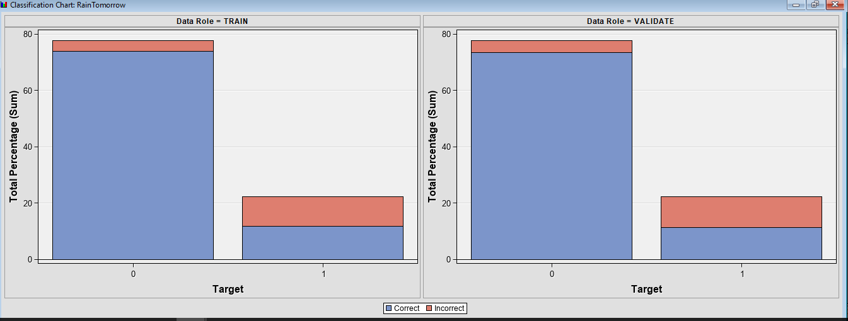
In both types of samples we can expect a mis classification by the decision tree. So increasing the maximum branch in decision tree did not reduce the misclassification.

Slide 23
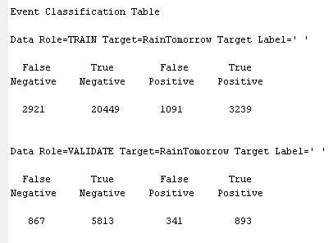
In last model, 877 samples of tomorrow's rainfall are predicted correctly but in this model 893 samples are predicted correctly. So the minority samples are predicted with higher accuracy by increasing the number of branches in decision tree.

Slide 24
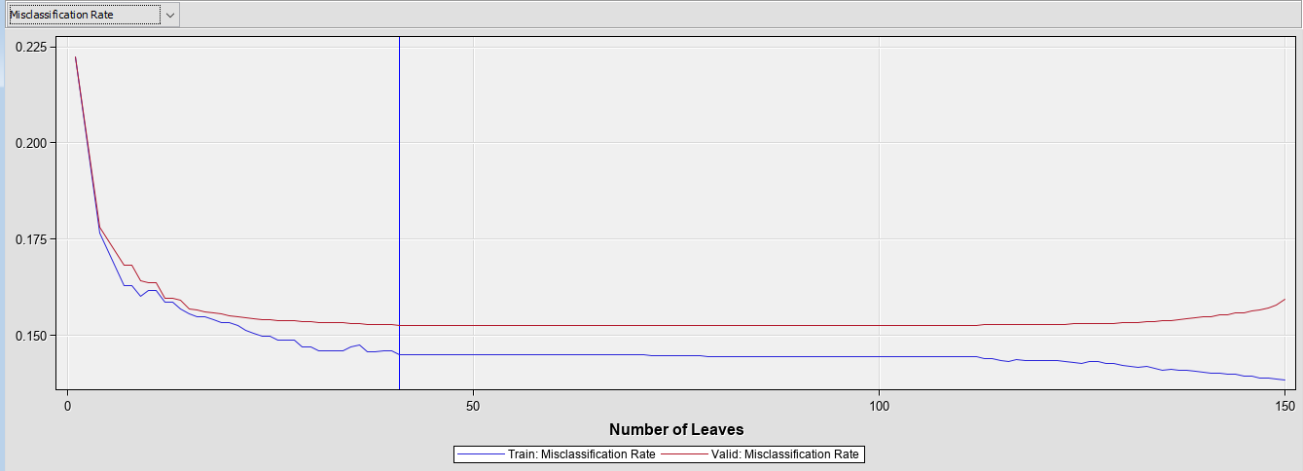
Using 41 leaves in the model we can expect the lowest error in validation samples but also over fitting can be seen from lower number of leaves where the error in validation data is much higher than the train data at different number of leaves.

Slide 25
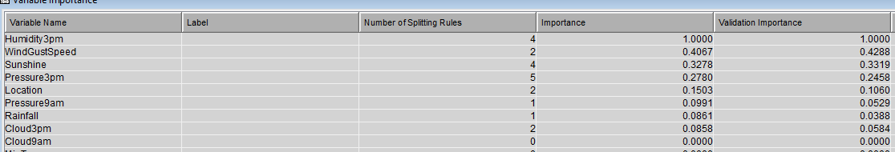
In this model also we can see humidity3pm is the highest important variable detected by the model.

Slide 26
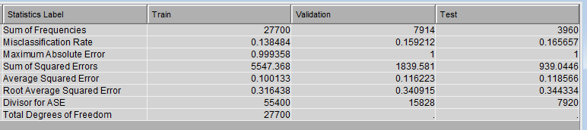
Decision Tree having Max branch=5 and subtree=largest
After increasing the branch, the error seems to be increasing in test data.

Slide 27
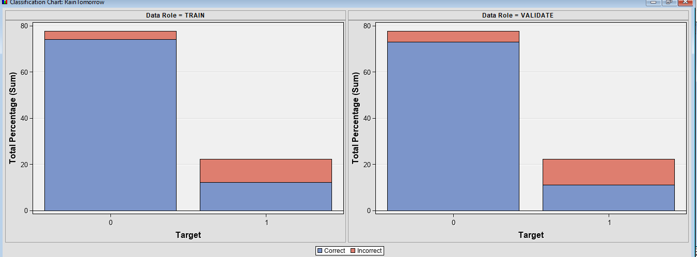
We can observe how decision tree with maximum number of branches are giving mis classification and in validation sample, the miss classification rate is higher.

Slide 28
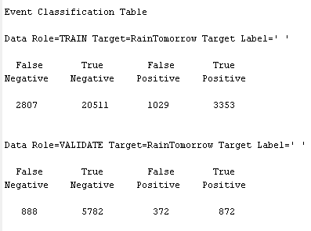
The last model gives 893 correctly classified samples but this model predicted 872 samples in validation data. The misclassification increased in the minority sample indicating increase in the maximum number of branches does not really help in increasing the accuracy in prediction of rainfall.

Slide 29
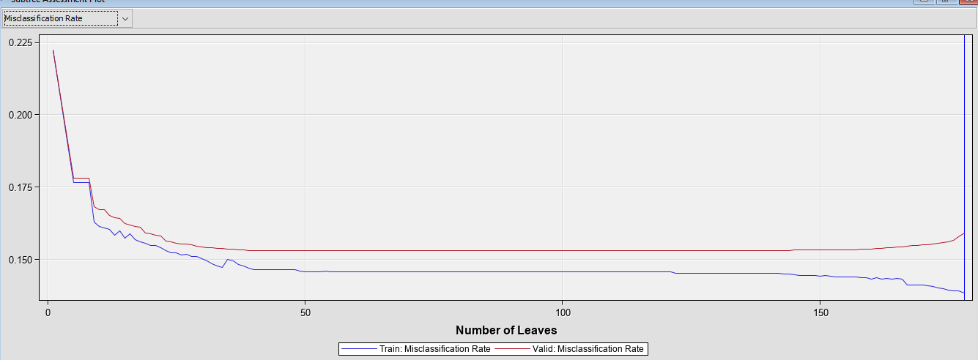
At 178 leaves, decision tree tends to give the minimum error in validation and training data but we can see that the error starts to increase with the increase of leaves in valid data. This model is also over fitting at higher number of leaves.

Slide 30
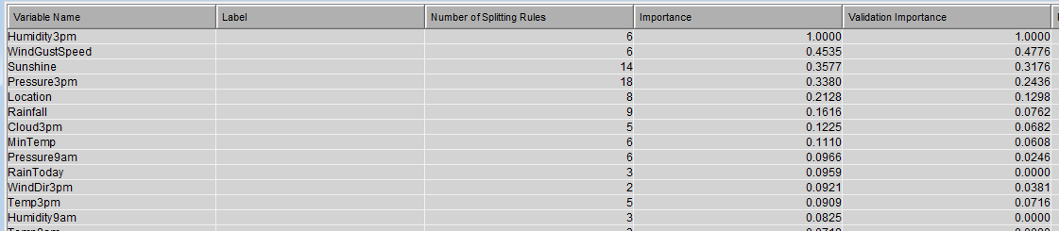
This model also confirms that Humidity3pm is the most important variable in prediction of tomorrow's rainfall.

Slide 31
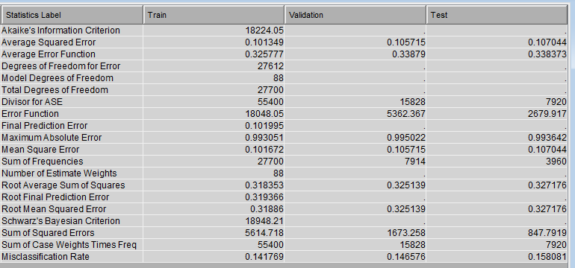
Logistic Regression
Logistic regression gives the minimum misclassification rate in test data compared to the decisions which makes the model the best fit for prediction of tomorrow's rainfall in Australia.

Slide 32
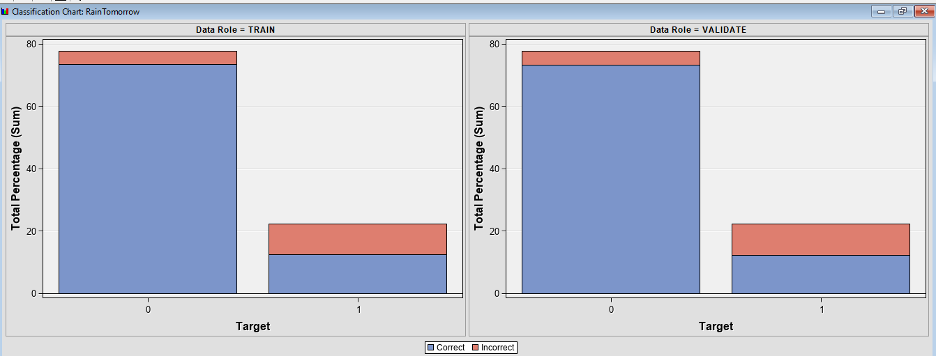
With considerable miss classified samples in the minority sample, logistic regression shows no over fittings as the misclassification rate in validation sample is also similar to the train samples.

Slide 33
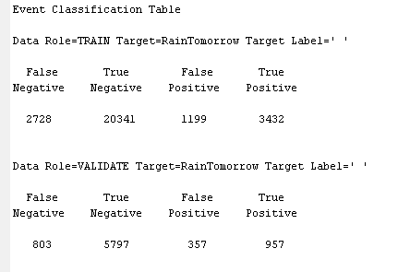
We can see that 957 samples are correctly classified that makes Logistic Regression as the best classifier that handle the minority samples and also give higher prediction performance of rainfall.

Slide 34
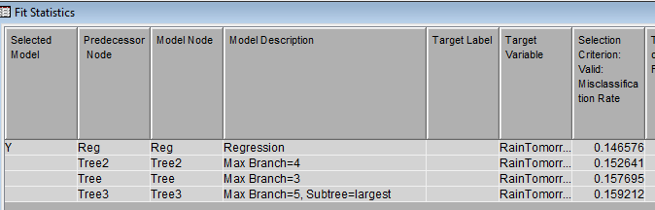
Model Evaluation Criteria and Final model
From the table, we can confirm that the Logistic regression give the lowest misclassification rate and also from overview of the logistic regression, we can see it gave the highest number of correctly classified samples of rainfall prediction.

Slide 35
Interpretation of the findings
Evening humidity is the most important variable to decide tomorrow's rainfall
Logistic regression seem to be the best model in prediction of rainfall in Australia
Overfitting issues occur with training decision trees with maximum branches
Recommendation
The daily data should be updated and the model should be retrained in the new data
Forecasting models like ARIMA or LSTM model can be implemented for better forecasting estimates
Data should be gathered from different regions outside of Australia to use the model globally
The models used should be tuned with more parameters for higher accuracy
For preventing overfitting, bagging classifiers can be used

Slide 36
Summary and Lessons Learned
Humidity is important to forecast rainfall
Temperature and Pressure have direct relationship
The minimum and maximum temperature correlates with rainfall
Other than that, we learnt visualization technique using Tableau and interpret the findings from different features of the data.

Slide 37
Future Work
The future work involves the following implementation
Forecasting models can be implemented in the data like ARIMA or RNN-LSTM
Feature Engineering of inputs like Wind speed or humidity can be performed for granular analysis
Weather forecasting models can be developed and deployed for rainfall prediction

